Slide 1
In-person Outreach Outdoors
Host Premises / Guests
Julia Gaudelli
Outreach Coordinator (Uniformed Groups)
G.A.S.
Outreach and Covid-19 Webinar - FAS - 9th Jan 2021

Slide 2
Beavers, Rainbows, Cubs, Brownies, Scouts, Guides, Explorers, Cadets
Schools
Universities
National Trust, U3A, WI, Wildlife Trust, Cathedral, golf club, visitor attraction
Collaborative events eg. World Space Week
Shared control of risk and mitigation
Lower risk due to open space
Control of traffic flow harder
More so with young people

Slide 3
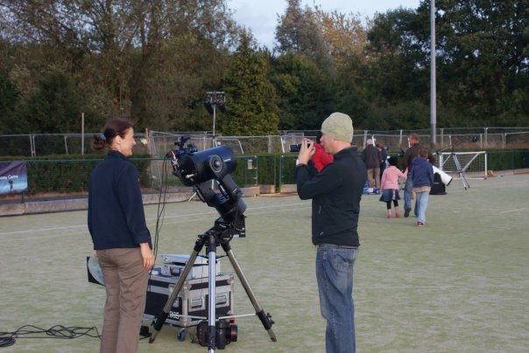
Location:
Host’s own premises
Public land
Private land
Considerations:
Space
Marshalling
Arrivals and departures
Facilities & hygiene
Equipment

Slide 4
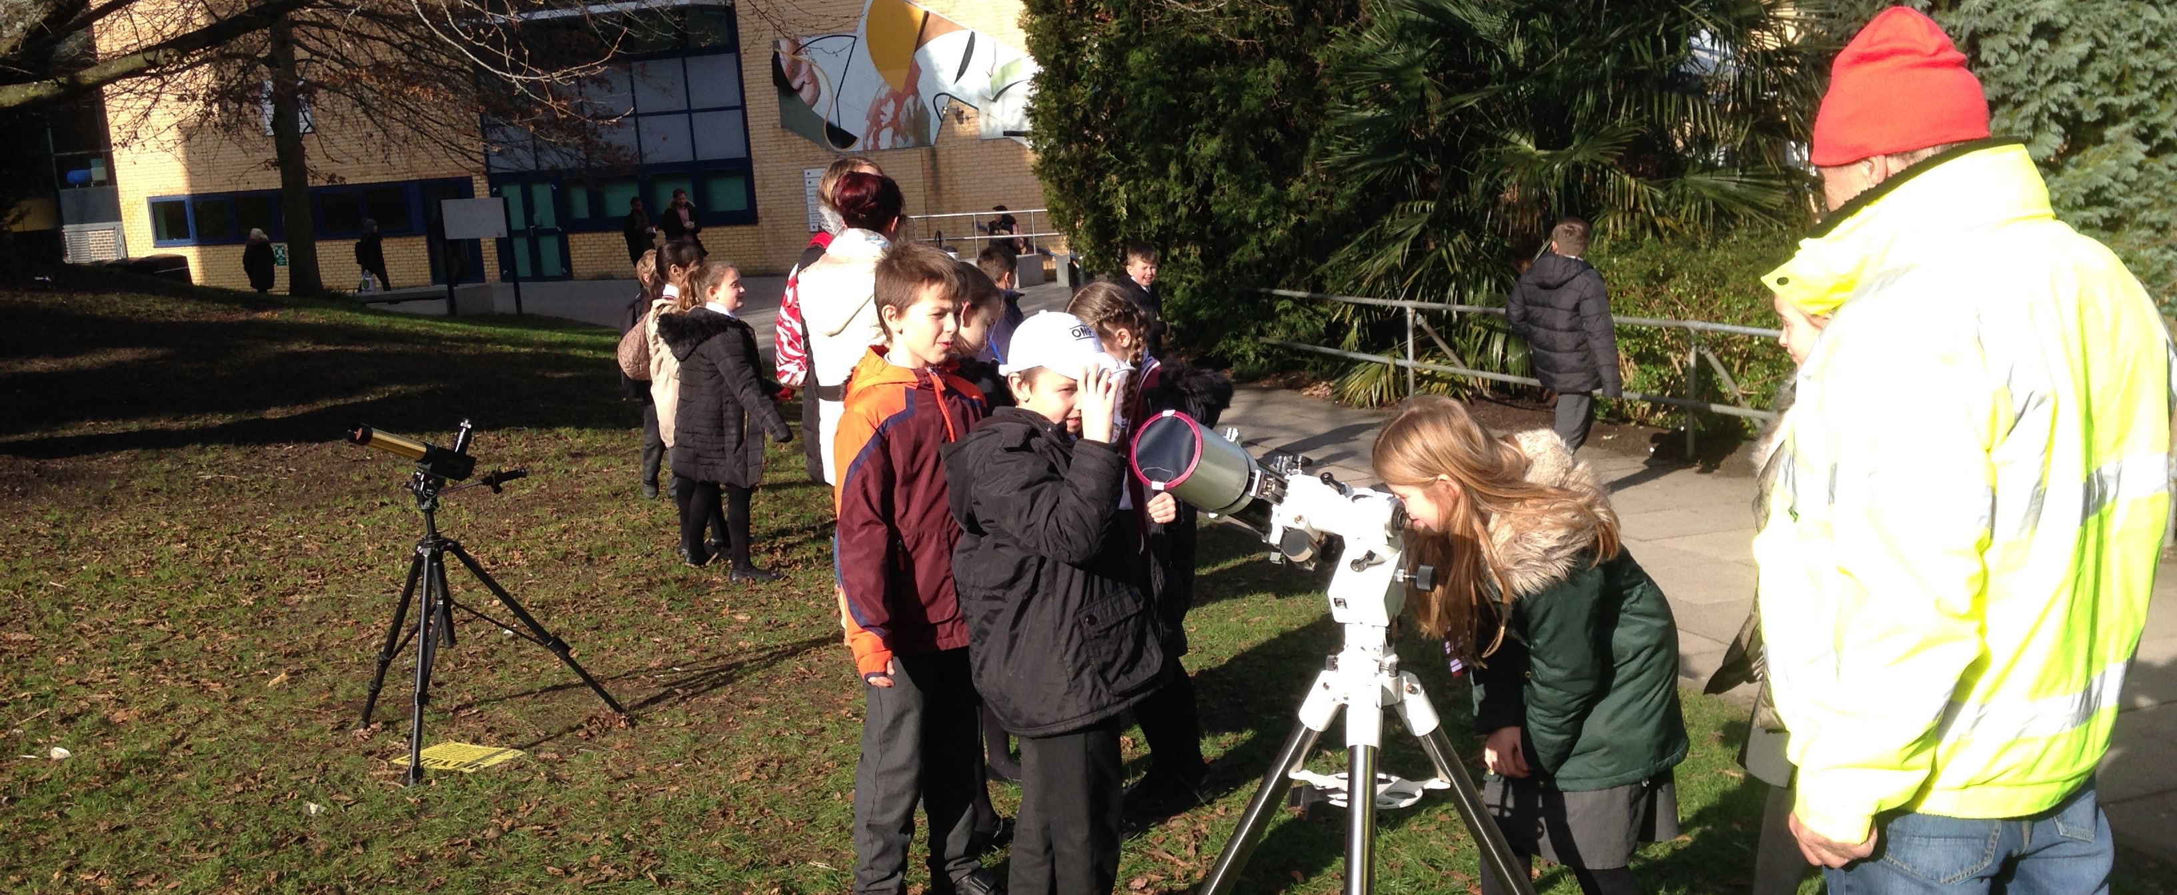
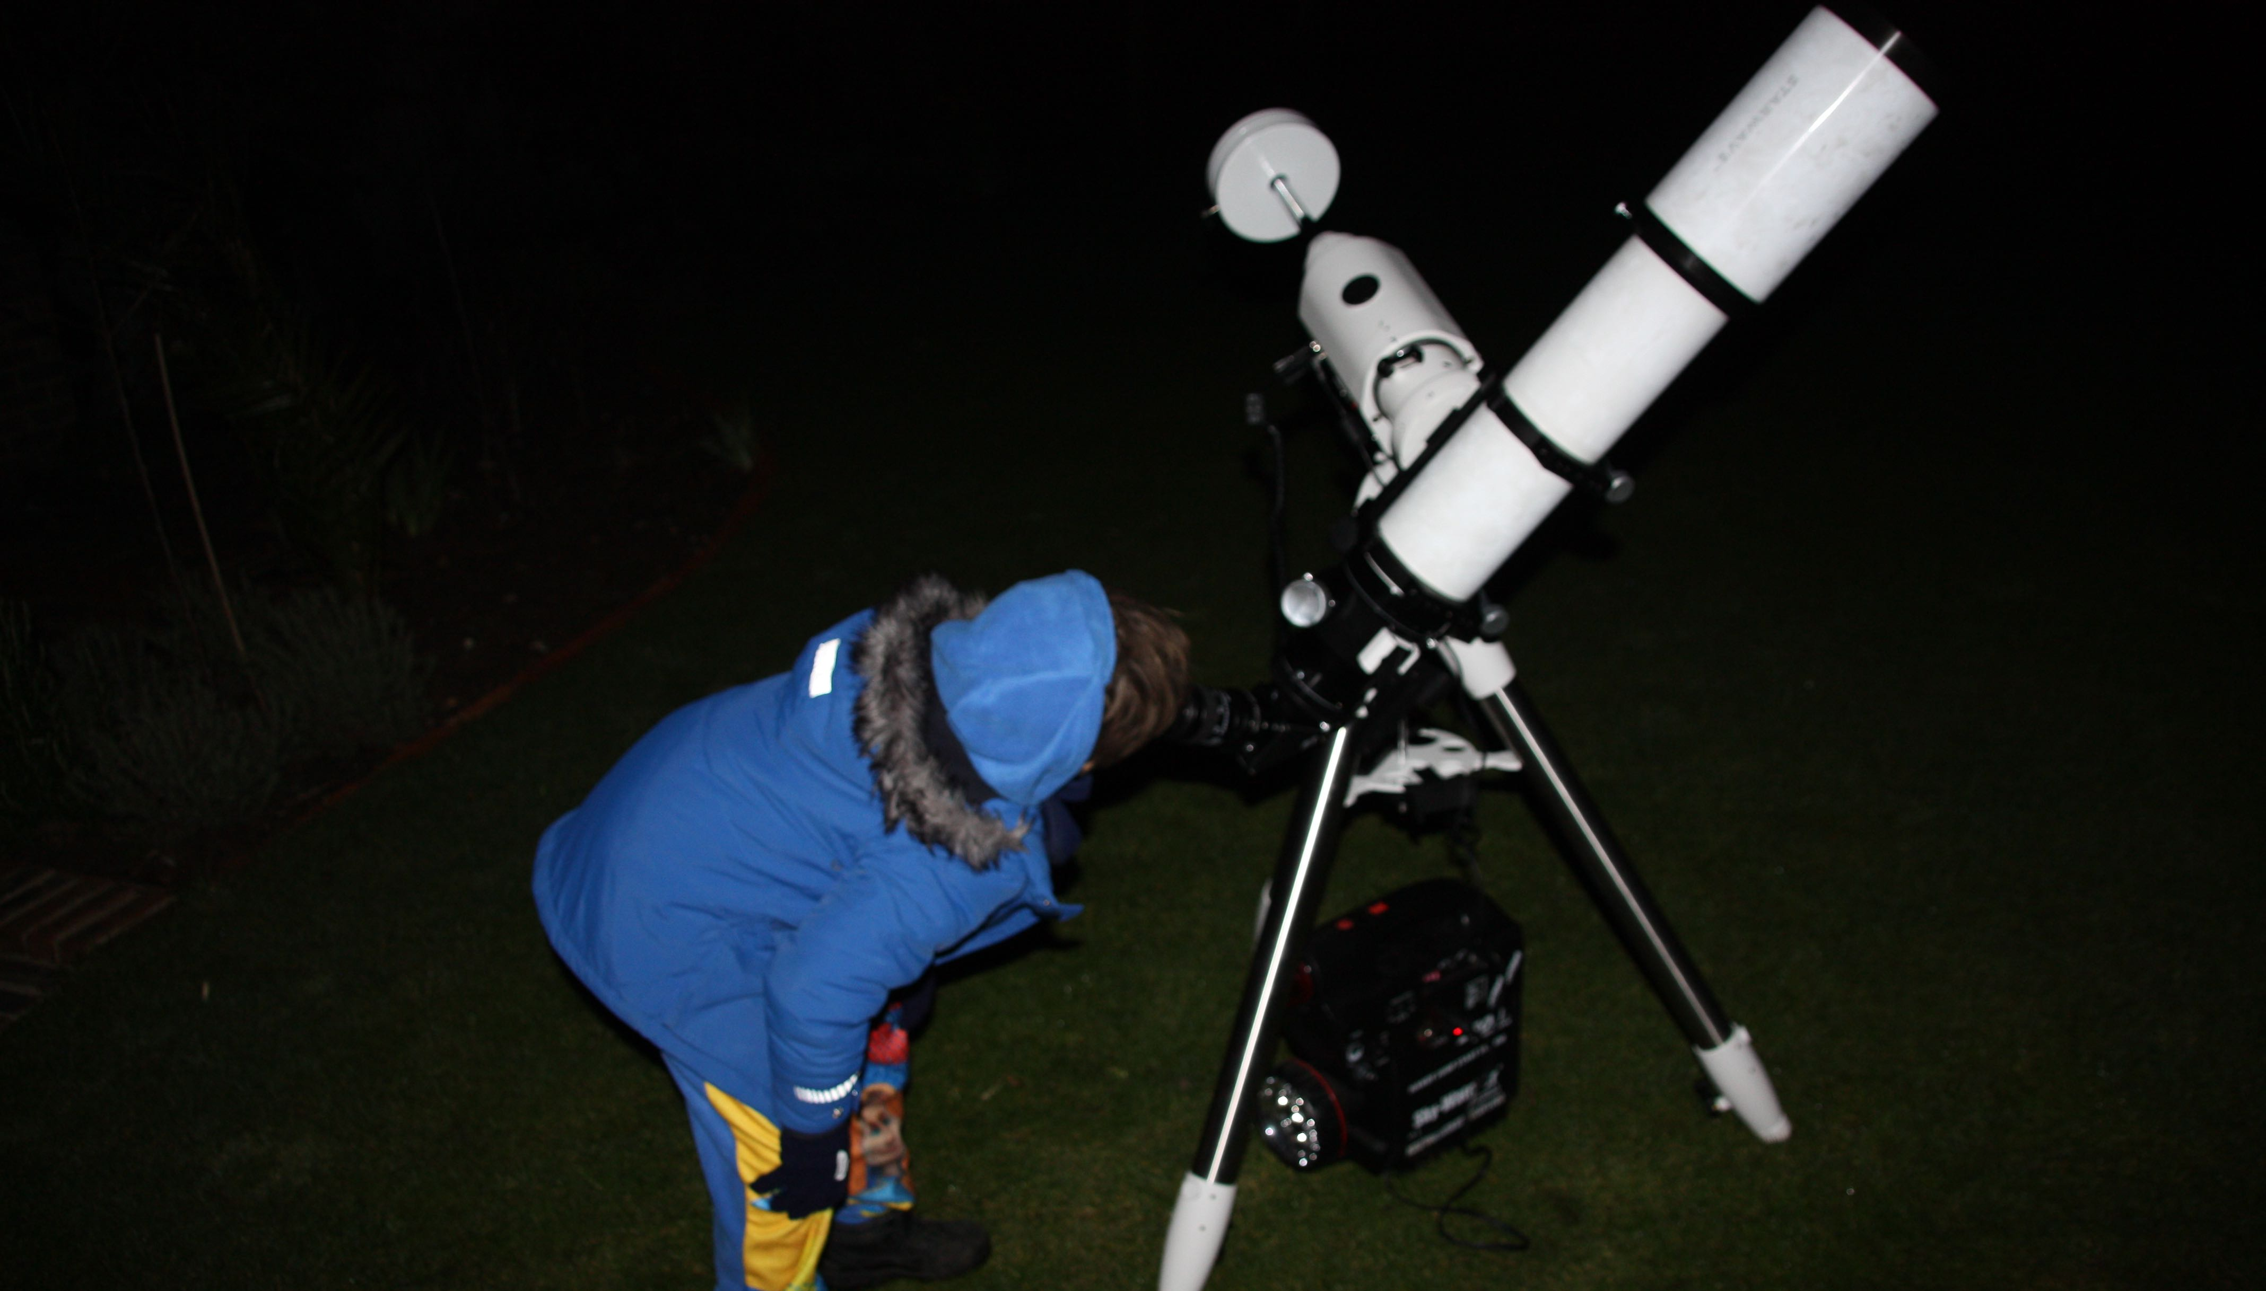
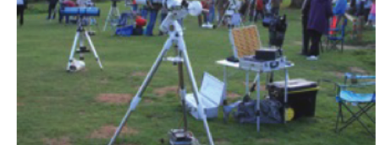

Slide 5
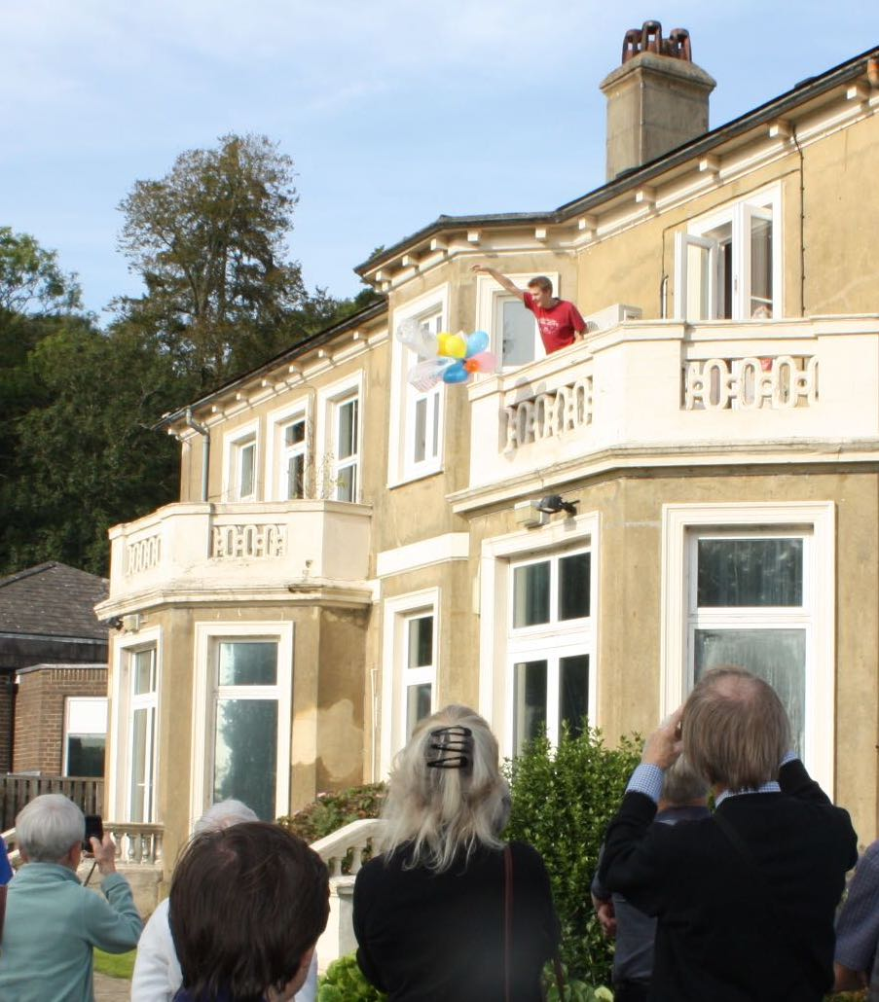
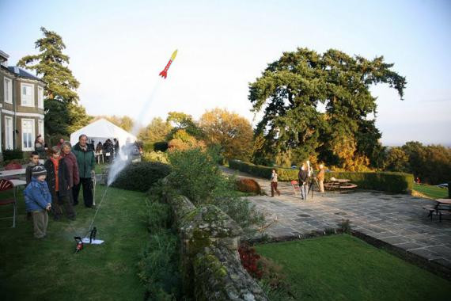
Build a model of the solar system using fruit or sports balls. Use an outside area to scale the solar system.
Read a star map using a compass and red light
Find the Pole Star
Look at the moon
Make constellation patterns
Make a model spacecraft from recycled materials
Make/Fire a model rocket
Find out about the ISS
Make impact craters
Mars egg lander

Slide 6
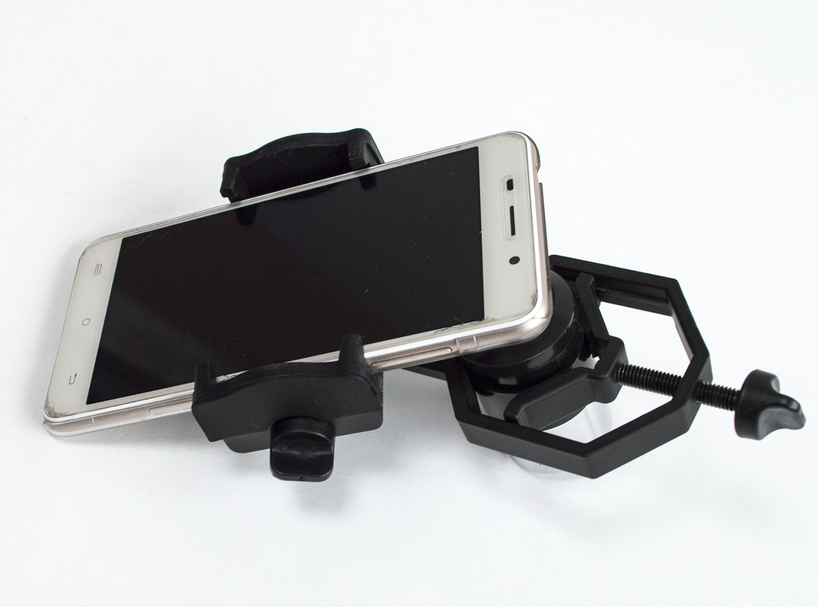
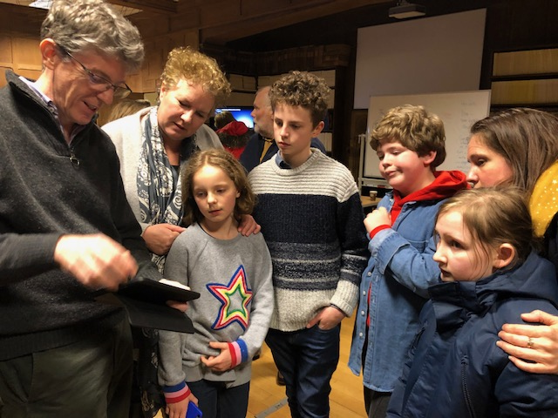
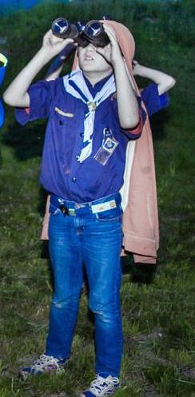
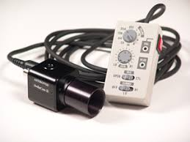
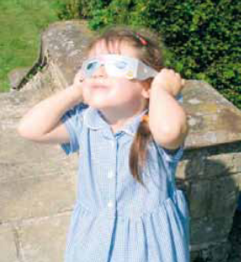
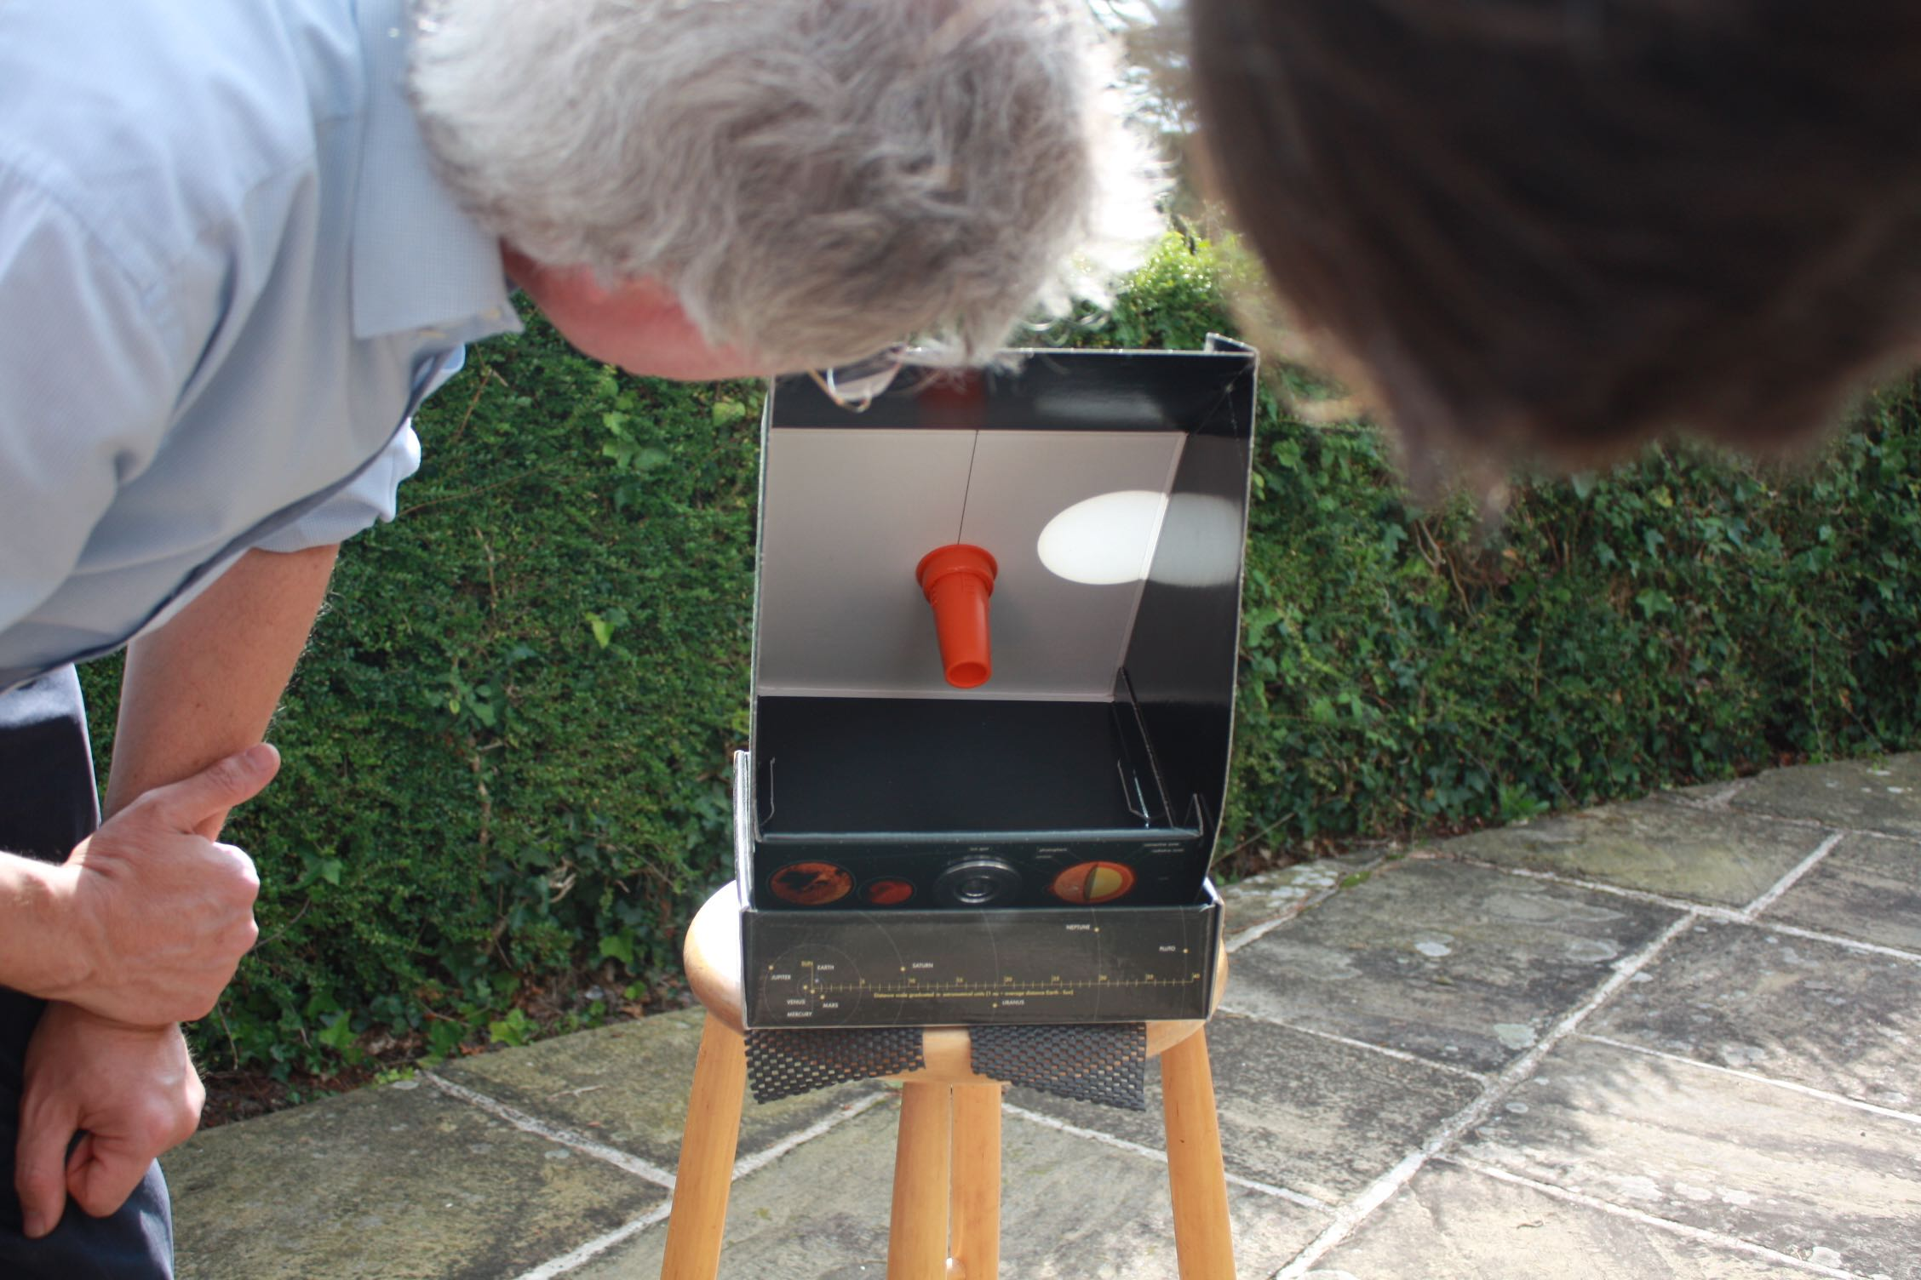
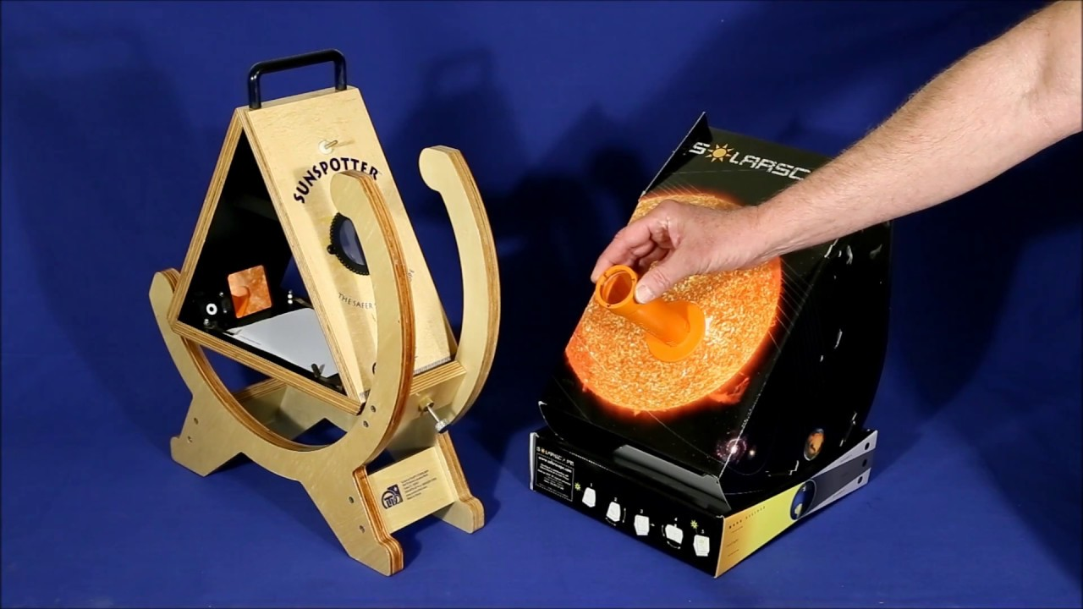
Self-led tour of the night sky – star map for each visitor
Presenter-led tour of night sky using laser pointer
Bring your own binoculars
Sky charts on mobile phone
Mobile phone clamp to telescope eyepiece
Spotting satellites www.heavens-above.com

Slide 7
Webcam/CCD/Stellacam output to large screen
Live images from remote telescope to screen/ tablet
Planetarium software to screen - Stellarium, Distant Suns, Starry Night etc.
Solar Observing using approved safety glasses, 1 pair per person
Solar observing via projection eg Sunspotter, Solarscope

Slide 8
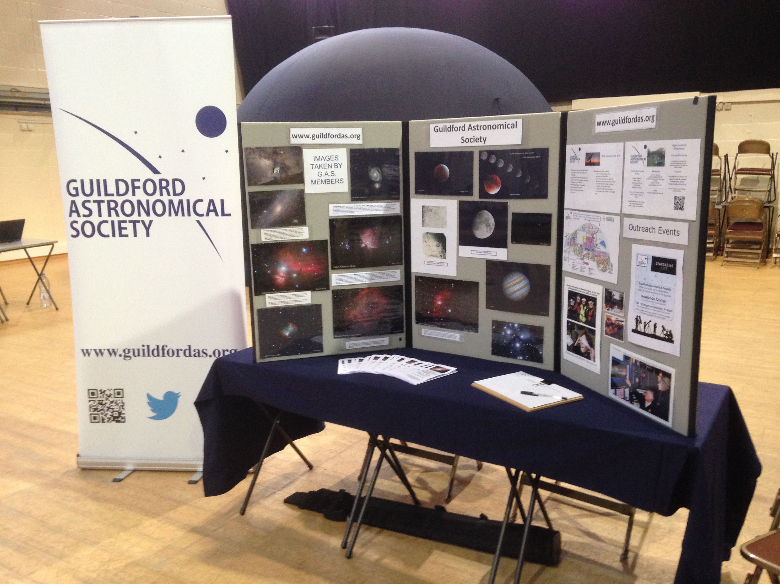
Thank you for listening
Questions ?

